Slide 1
Proposal Presentation for Fire-Based Random Number Generator
Chad Schwenke & Tristan Sauer – CS 4910

Slide 2
Why do we need random number generators?
Cryptographic applications need to create random numbers that are difficult to predict
These random numbers can be used as secret keys for symmetric ciphers, session keys for live applications, and more
The use of weak PRNGs is now considered a CVE by MITRE
https://cwe.mitre.org/data/definitions/338.html

Slide 3
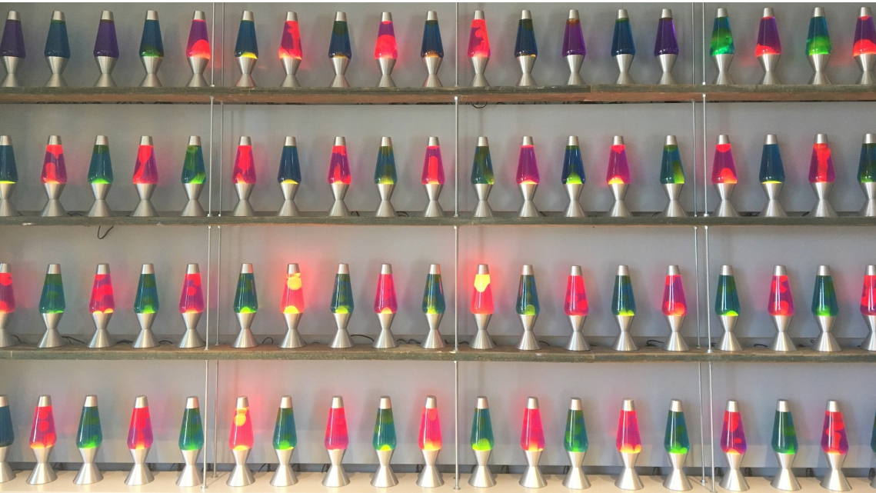
Similar prior work and inspiration
Chen, I-Te. “Random Numbers Generated from Audio and Video Sources.” Mathematical Problems in Engineering 2013 (2013): 1-7.
Others have tried using video and audio sources to create randomness, however this research struggled to create randomness from a single audio or video source
In Cloudflare’s headquarters, there is a wall of lava lamps used as a source of randomness (Lavarand)
https://blog.cloudflare.com/lavarand-in-production-the-nitty-gritty-technical-details/

Slide 4
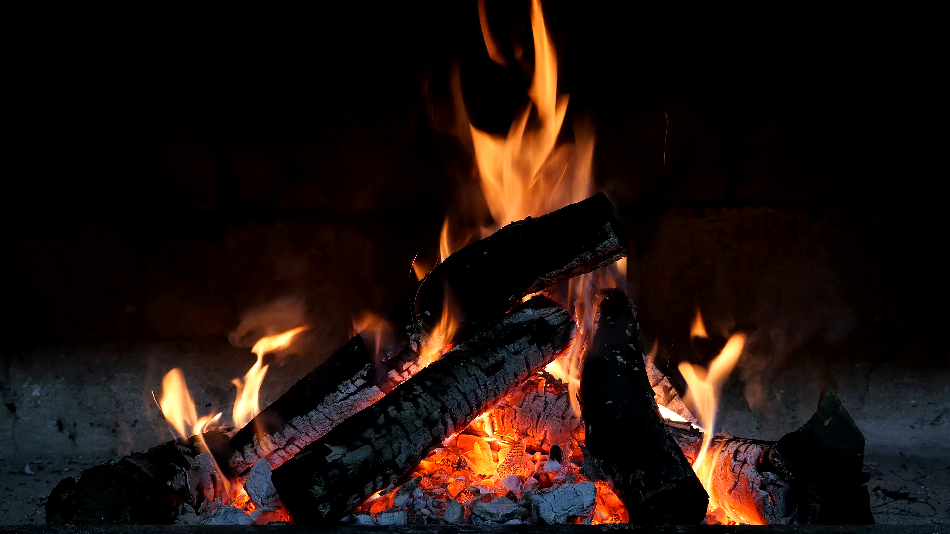
Our proposed method
Use MP4 footage of a real-life fire (open-source video for initial test)
Fire in real life has lots of chaos (wind speeds, oxygen levels in the air, shape of wood, etc.)
Real-life systems with high chaos are virtually impossible to predict with current hardware
A single 1080p frame with 8-bit color has 16,777,216^2,073,600 possibilities, that’s a lot of entropy!
Source - https://www.pexels.com/video/burning-charcoal-fire-854692/ by user Pixabay

Slide 5
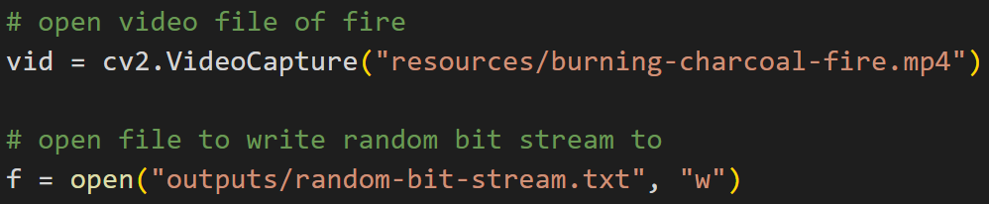
Steps for random number generation using fire footage
Step 1: Open MP4 footage using OpenCV and load text file to store output of the random bit stream (ASCII 1s and 0s)

Slide 6
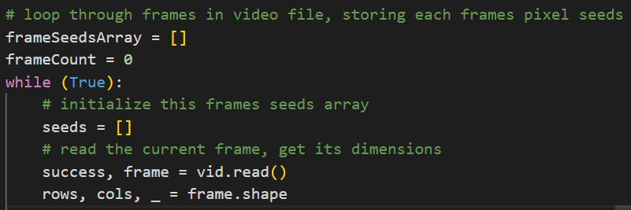
Steps for random number generation using fire footage
Step 2: Begin looping through frames (represented as single PNGs), initialize arrays to write temp seeds to, extract frame information

Slide 7
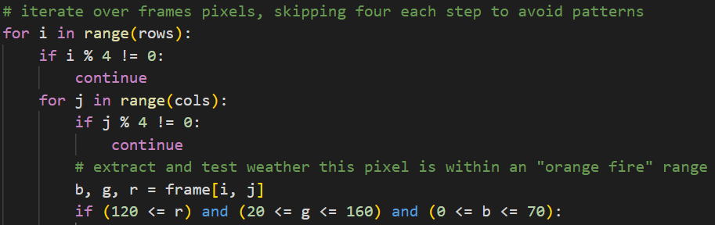
Steps for random number generation using fire footage
Step 3: Traverse image pixels row by column (skipping 4 each dimension to avoid pattern making), test if pixel is an “orange fire” color

Slide 8
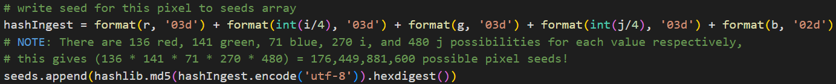
Steps for random number generation using fire footage
Step 4: If the pixel was an orange color, concertante its red, green, blue, and location information into a string, md5 hash this string and store it (128-bit hashes)
Do this for all the current frame’s pixels, then store the whole frame’s information in final seed array, then go onto the next frame…

Slide 9
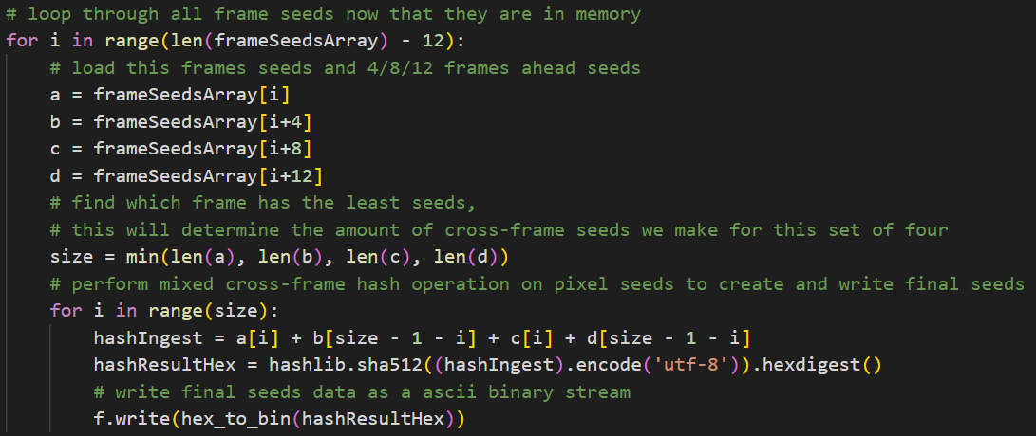
Steps for random number generation using fire footage
Step 5: Look at the current frame and 4, 8, and 12 frames ahead, make hash based on four different pixels from each of the frames

Slide 10
Preliminary Results
Using NIST SP 800-22, A Statistical Test Suite for Random and Pseudorandom Number Generators for Cryptographic Applications, we tested the output of our random bit stream
https://github.com/terrillmoore/NIST-Statistical-Test-Suite

Slide 11
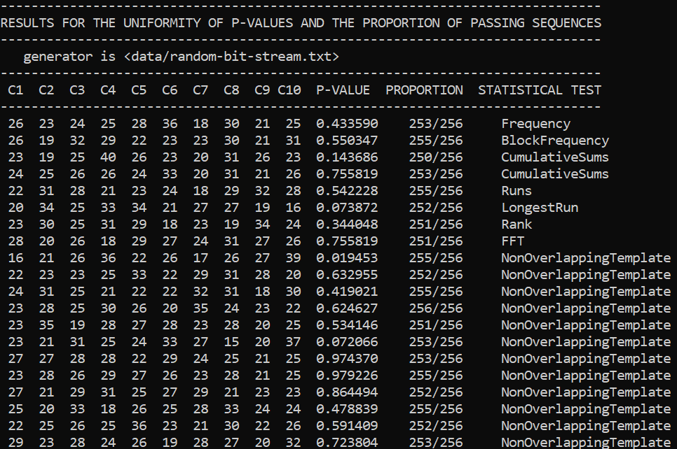
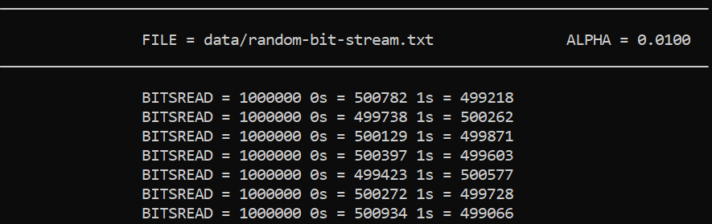
Preliminary Results
The results showed that we successfully passed all randomness tests (need 248 in each proportion)
Tested 256 different bit streams, each one million bits long

Slide 12
Team Background
Chad Schwenke
BI Computer Security
Interned at CableLabs as a security engineer
Full stack development experience
CS4920
Tristan Sauer
BI Computer Security
Part Time Employee at Lockheed Martin
CS4920
2 AAS in Computer Networking Technology
Security+ certified

Slide 13
Next Steps
Use our own live footage from firepit at Tristan’s house using 1080p webcam
Optimize code so that it can create random bit stream in real-time (take advantage of RTX 3080 Ti GPU)
Test efficiency of our implementation versus other industry implementations

Slide 14
Questions?

